Slide 1
Zone Extents: Te Kowhai
Evidence Highlights
Bevan Houlbrooke for
Greig Metcalfe

Slide 2
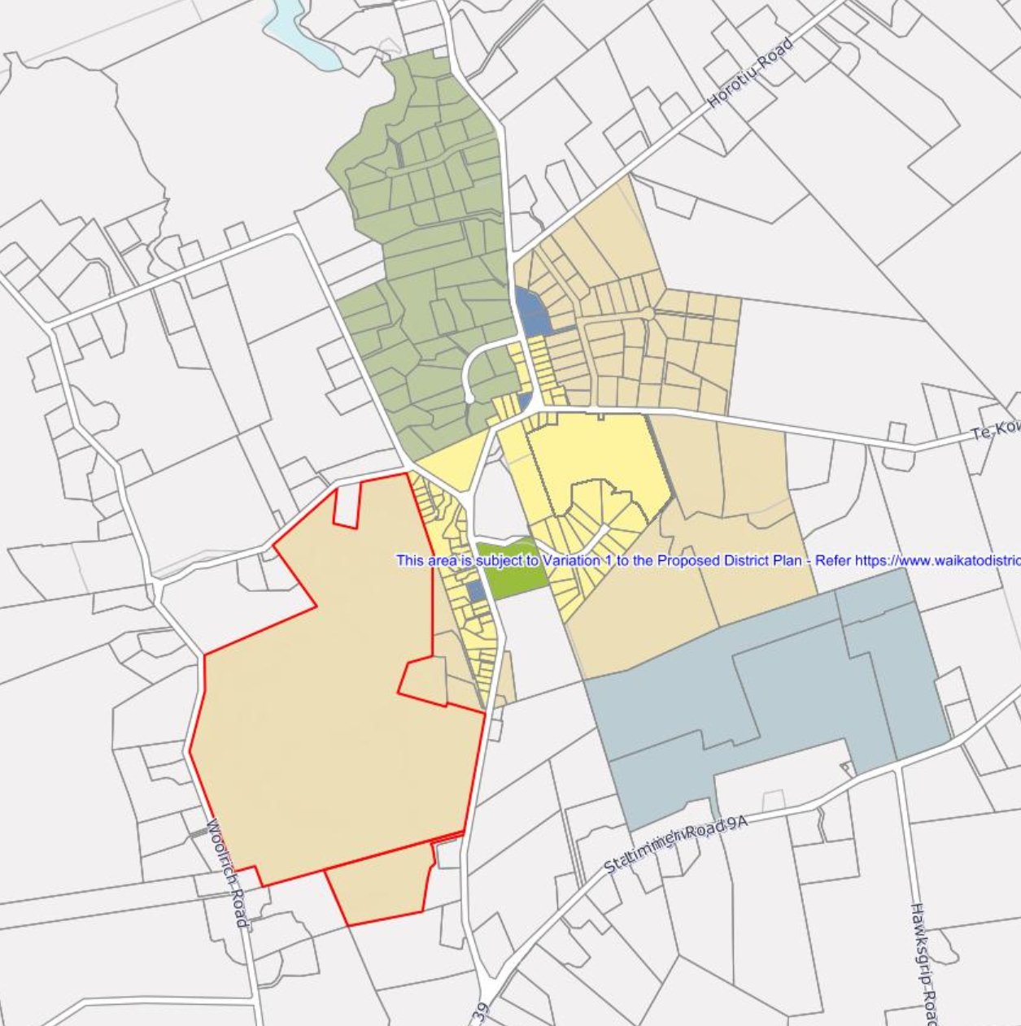
Metcalfe property
68 ha on the western edge of Te Kowhai village.
On-going dialogue with Council staff since 2017.
Proposed as Village Zone under the WPDP.
Submission in support of proposed zoning.

Slide 3
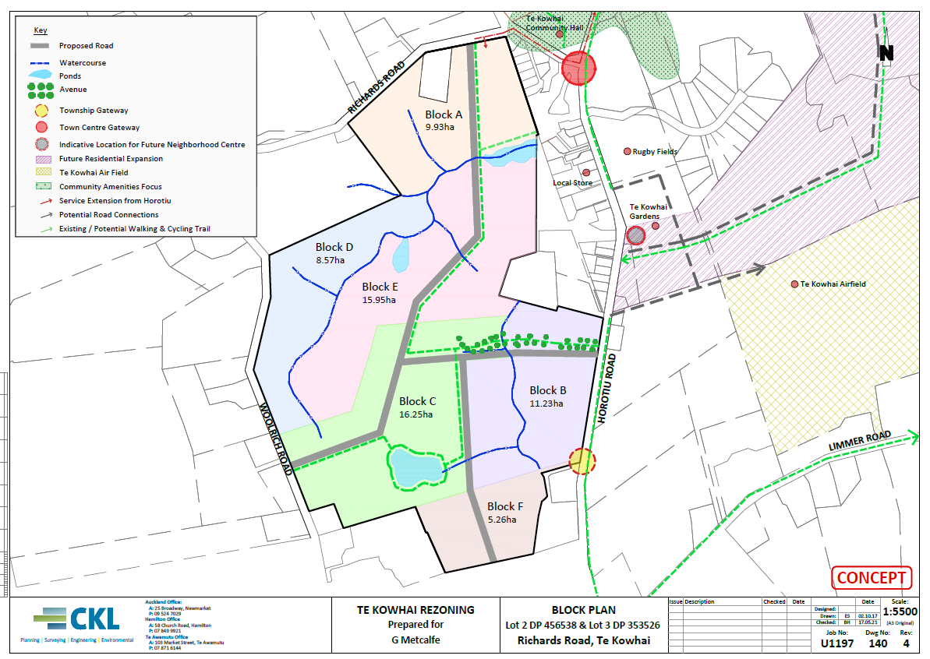

Slide 4
Basis for Te Kowhai as growth area
Future Proof 2017 identifies Te Kowhai as a village to be prioritized for growth.
Waikato 2070 identifies the Metcalfe property as a residential growth node.

Slide 5
s42A
Agreement the Metcalfe block is suitable in principle for rezoning.
Recommends that the Metcalfe property may be more appropriate as Future Urban Zone rather than Village Zone.
Basis for this recommendation is that once wastewater services and a structure plan are in place, it may be most appropriate long term as a Residential Zone.
Uncertainty regarding timeliness and funding of network infrastructure.

Slide 6
Metcalfe response
Greig Metcalfe is seeking a live zoning as he wants to advance subdivision and development as quickly as possible.
Development likely to proceed in stages, initially with a retirement village and large lot residential on some of the steeper areas of the site. These could proceed without trunk infrastructure.
Extension of wastewater to Te Kowhai from Horotiu is identified as unfunded projects in the 2021-31 LTP. The reason it was recommended to be unfunded is that the zoning is yet to be confirmed.

Slide 7
Response cont.
LTP estimates the cost of wastewater extension to be $9m. Based on a potential yield of 835 houses in the Village Zone, it would cost approx. $11,000 per lot. This is a viable development proposition.
Greig Metcalfe willing to engage with WDC and Watercare to fund infrastructure provision outside of LTP budgets.
Request that consideration be given to providing Te Kowhai a live zoning.

