Slide 1
Hearing 25: Zone Extents Mercer & Meremere
Location relative to nearby town

Slide 2
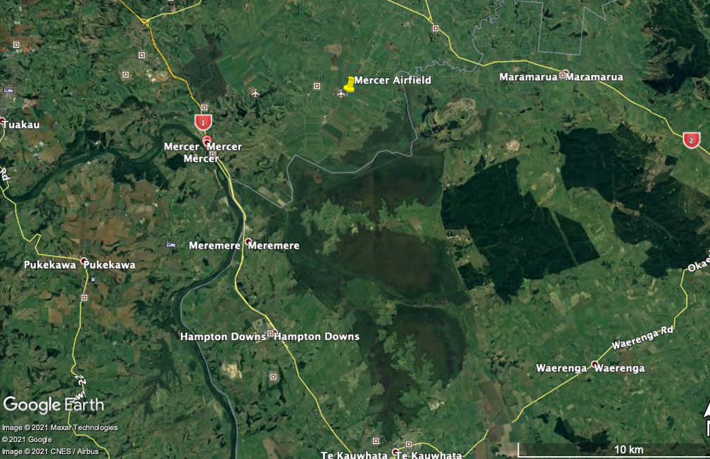

Slide 3
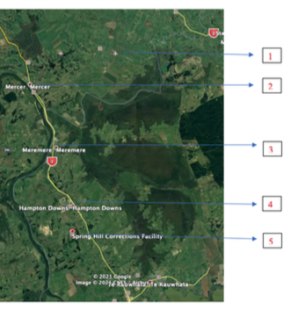
Overview
1. Specific zone: Mercer Airport
2. Mercer Village extension (Lot 9 DP 461781)
3. Meremere Industrial/Business (25 Island Block road)
4. Hampton Downs motor sport and recreation zone extension (Lot 6 DP 411257)
5. Special Zone: Corrections (Springhill Prison, Hampton Downs Road).

Slide 4
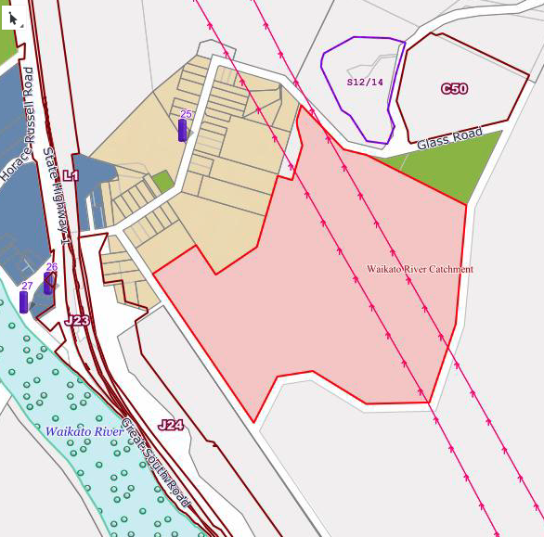
Mercer village extension
Mercer village
Lot 9 DP 461781

Slide 5
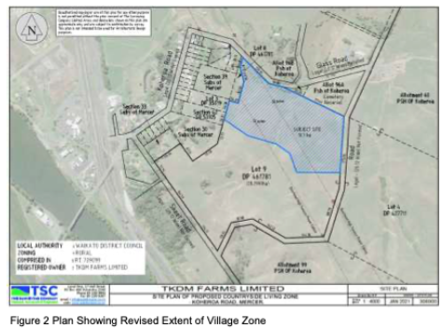
Mercer village extension
Lot 9 DP 461781

Slide 6
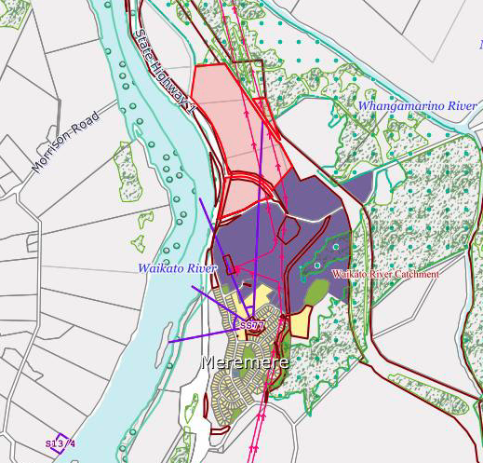
Meremere industrial / business zone
25 Island block road
Meremere

Slide 7
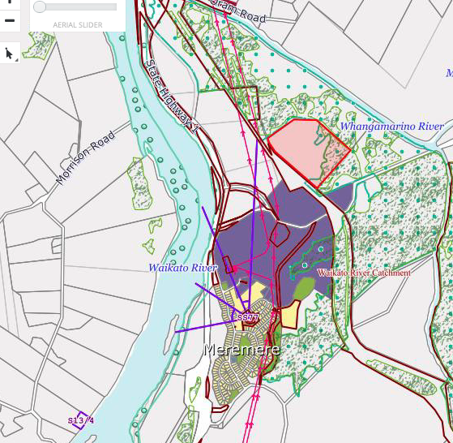
Meremere industrial / business zone
25 Island block road
Meremere

Slide 8
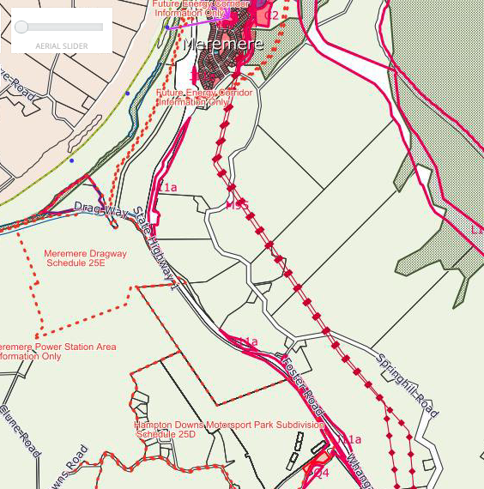
Hampton Downs motorsport and recreation zone extension
Meremere
Hampton Downs Motorsport Park

Slide 9
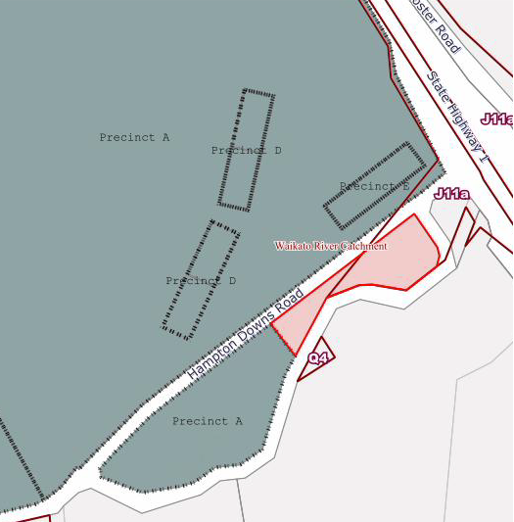
Hampton Downs motorsport and recreation zone extension – Lot 6 shown in pink

Slide 10
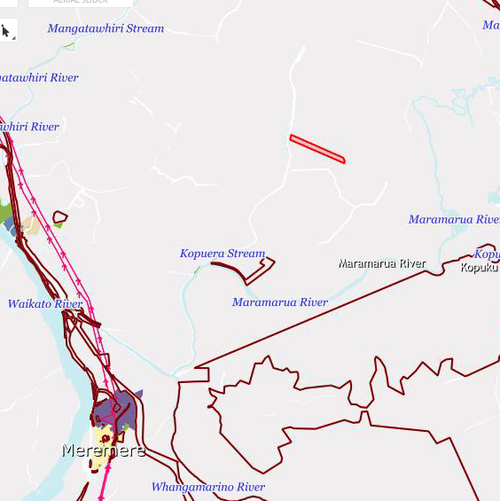
Mercer Airport special zone
Mercer airfield
Meremere

Slide 11
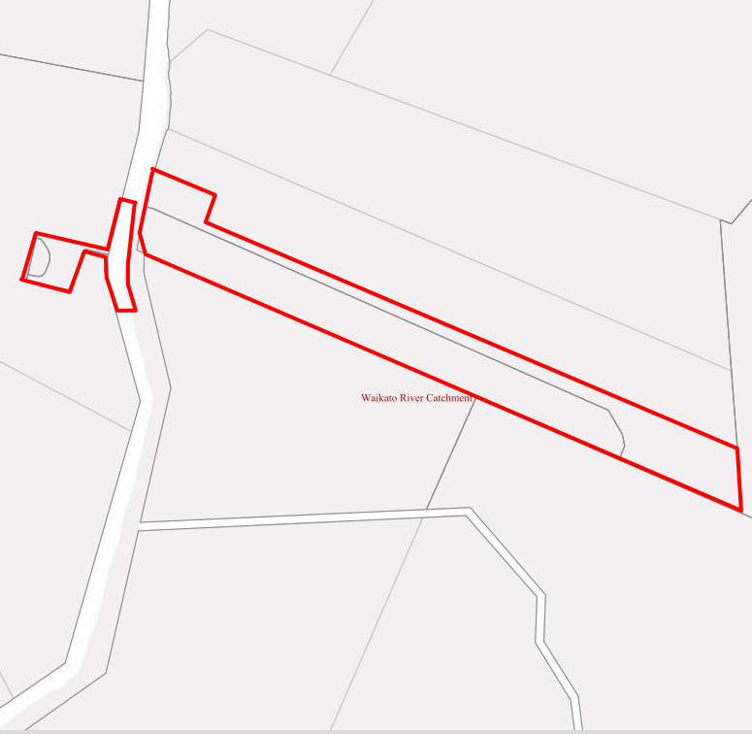
Mercer Airport Special Zone

Slide 12
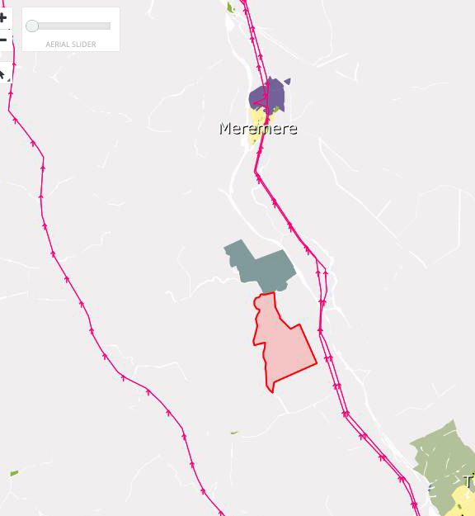
Corrections special zone
Meremere
Corrections special zone

