Slide 1
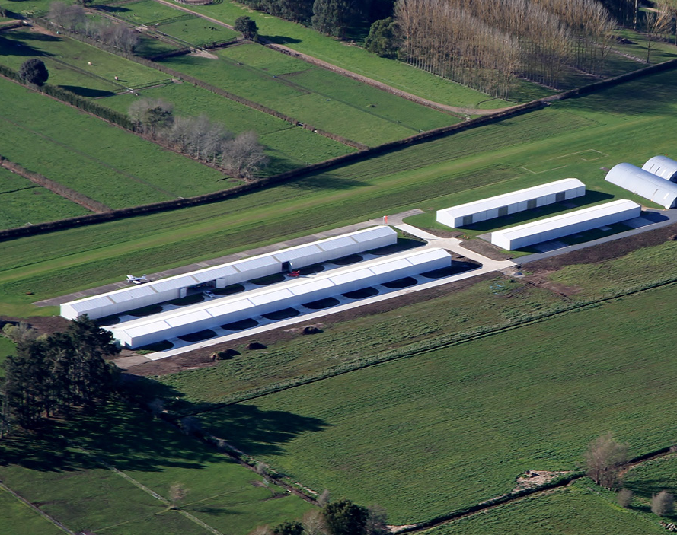
Greig Metcalfe Hearing 17 Te Kowhai Airpark
Evidence Highlights by Bevan Houlbrooke

Slide 2
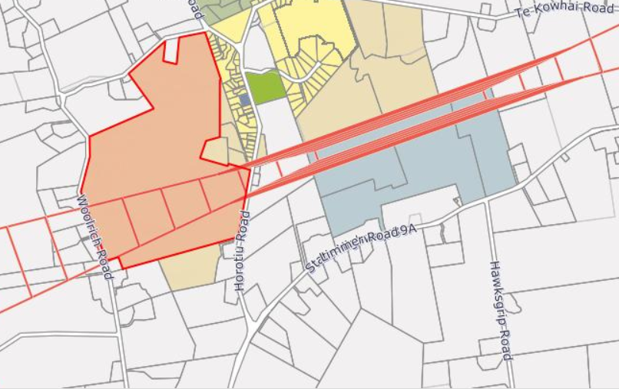
Metcalfe Property
62ha to the west of the Te Kowhai Airpark
Subject to Airport Obstacle Limitation Surface (OLS) under ODP and PDP.
Subject to the Outer Control Boundary (OCB) as sought by NZTE submission.
Zoned “Village” under the Proposed Waikato District Plan (WPDP) and identified in Waikato 2070 as growth node.
Contains many mature specimen trees which are a feature of the property and surrounds.

Slide 3
Flight Training School & Circuit Training
Greig Metcalfe requested Flight Training Schools and Circuit Training are provided for as non-complying activities.
Repeated circuits, touch and go landings and engine stalls have the potential to induce neighbor anxiety and adversely effect the amenity values of the area.
Waharoa Aerodome is an example of where neighbors have reportedly been adversely affected by flight training schools and circuit training.
Greig Metcalfe supports the recommendation in the s42A report which provides for flight training school and circuit training as a non-complying activity.

Slide 4
Definitions
Greig Metcalfe requested that definitions be provided for “general aviation” and “recreational flying” as they were terms not defined in the WPDP.
Definitions will avoid ambiguity and uncertainty as to what these activities entail.
The s42A report has recommended general aviation and recreational flying be deleted as activities and replaced with a single activity “aircraft operations”. Greig Metcalfe supports this recommendation.

Slide 5
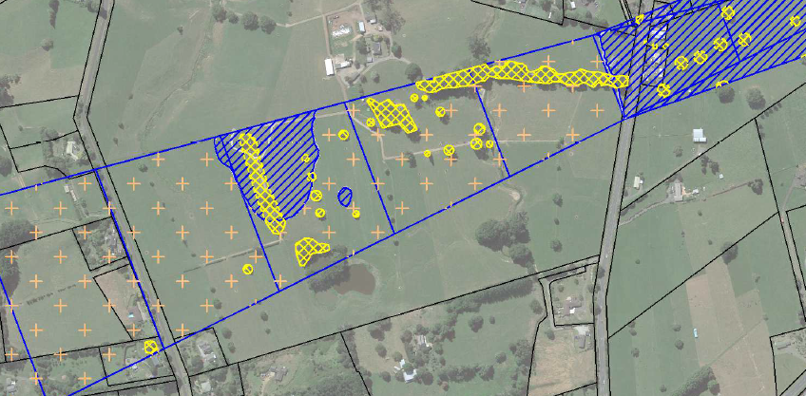
Airport Obstacle Limitation Surface (OLS)
Greig Metcalfe opposes the introduction of an OLS based on Instrument Flight Rules (IFR) and requests that the OLS reverts to the one from the WODP which is based on Visual Flight Rules (VFR).
The proposed OLS based on IFR is lower than the existing based on VFR.
The lower OLS impacts 40+ existing trees (yellow) and comes within 10m of the ground level in three places on the property (blue).

Slide 6
Airport Obstacle Limitation Surface (OLS) [cont.]

Slide 7
Airport Obstacle Limitation Surface (OLS) [cont.]
WODP only controls the height of buildings and structures in the OLS, not trees or vegetation.
Existing use rights potentially apply to the existing trees (s10 RMA).
Potential for existing trees to remain as an exception, but this usually requires an Aeronautical Study (CAA Part 157 Study). No study has been undertaken, so is there uncertainty as to the ability to implement the OLS based on IFR?
Greig Metcalfe as a landowner is uncertain where responsibility lies for making the trees comply with the OLS, both initially and on-going. Further clarification is needed.
Greig Metcalfe supports the s42A report recommendation to adopt on OLS based on VFR but seeks clarity on the implications for existing trees and compliance moving forward.

Slide 8
Airpark Operations
Greig Metcalfe requested:
Maximum of 21,000 aircraft movements per annum (a number originating from the s32)
Hours of operation to exclude night flying (which is enabled by IFR, but requires lighting infrastructure)
Preparation of an Airpark Management Plan and Noise Management Plan with consultation with affected neighbours and which takes into account Fly Neighbourly principles.
Greig Metcalfe supports the recommendation in the s42A report to cap aircraft movements to 15,000 per annum and the subsequent adjustment to the Outer Control Boundary (OCB); and to restrict flying outside of 0700 to 2200 hours.
Greig Metcalfe would like to engage with NZTE on fly neighbourly matters.

Slide 9
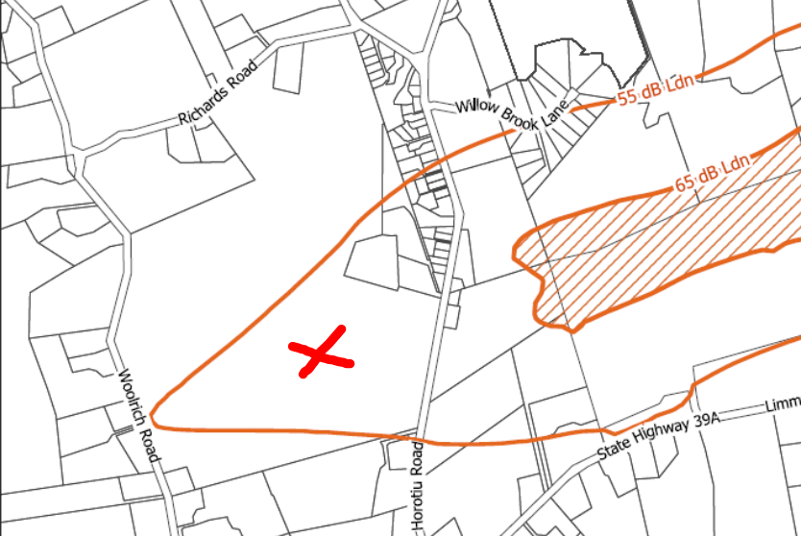
Outer Control Boundary (OCB)
The OCB as notified by the PDP did not affect the Metcalfe property. The amended OCB requested by NZTE results in the OCB extending onto part of the Metcalfe property.
Greig Metcalfe generally supports the recommendations in the s42A regarding the T+T OCB and amended rules and policies,
Greig Metcalfe requests rules 22.1.5 and 24.1.3 do not apply to land that falls within the 55 dB Ldn contour.

Slide 10
Conclusion
Greig Metcalfe is not opposed in principle to the airpark and considers there is an opportunity for the airpark and Te Kowhai community to successfully co-exist.
Greig Metcalfe requests additional controls to ensure the scale and associated effects of the Airpark are appropriately managed to ensure neighbors are not unduly adversely affected. This includes restrictions on flight schools, circuit training, night flying and a cap on annual aircraft movements.
Greig Metcalfe is concerned about the impact of the OLS will have on mature trees and is uncertain as to how this issue will be resolved.

